Slide 1
Inverse procedural Street Modelling: from interactive to automatic reconstruction
Phd Defense : Rémi Cura, 2016/09/12
Université Paris-Est
École Doctorale Mathématiques et Sciences et Technologies
de l'Information et de la Communication (MSTIC)
Jury:
Pr. Christian Heipke (IPI) R
Pr. Peter Van Oosterom (TUDelft) R Dr. Florent Lafarge (INRIA) E
Pr. Gilles Gesquière (LIRIS) E
Dr. Julien Perret (IGN) S
Dr. Nicolas Paparoditis (IGN) D
Dr. Kevin Lyvan (Thales) S
Notes:
Parler du context de la these :
Entreprise/labo
Projet terra mobilita

Slide 2
Foreword about this presentation
Work : 3 years
Presentation : 45 minutes
→ compression problem
Lossless
Only a summary, details in the articles/manuscript
High bandwidth: it’s going to be fast, apology

Slide 3
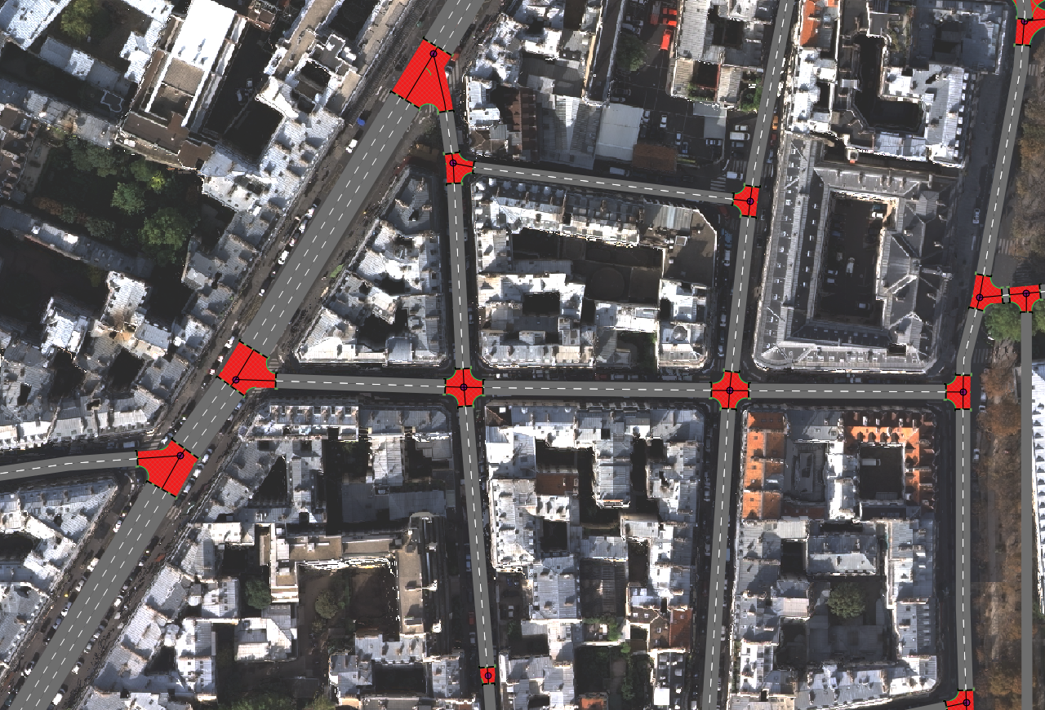
Abstract
Procedural street modelling:
Have a mode of streets!

Slide 4
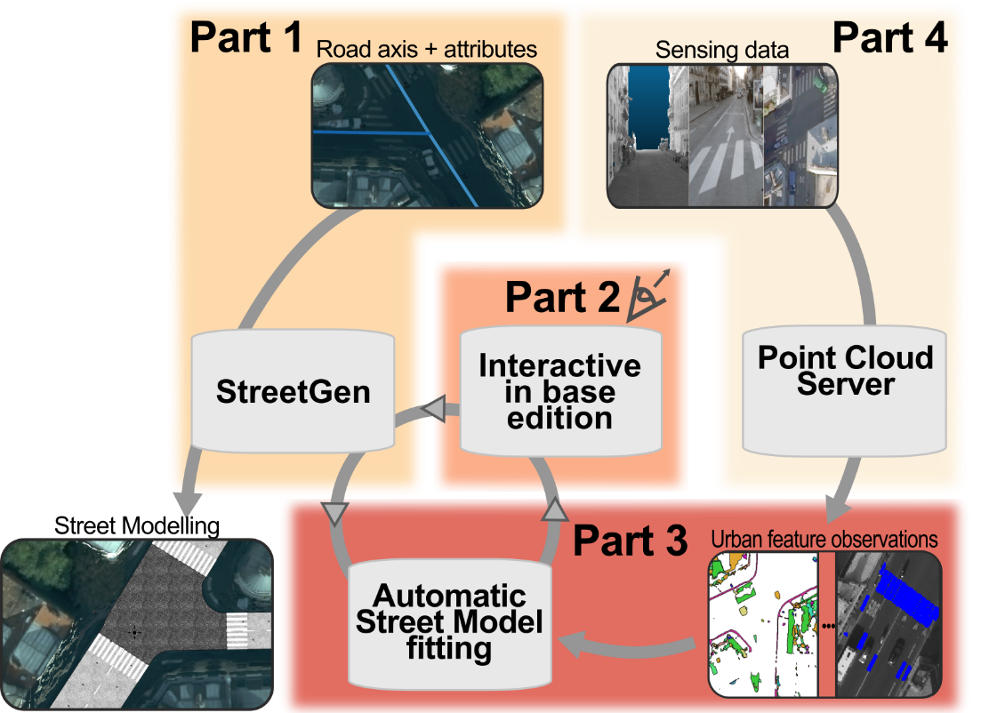
Abstract

Slide 5
Abstract

Slide 6
Abstract

Slide 7
Abstract

Slide 8
Abstract
All parts +
Intro
State of the art
conclusion

Slide 9
Introduction
Why model streets?
Usages for street model

Slide 10
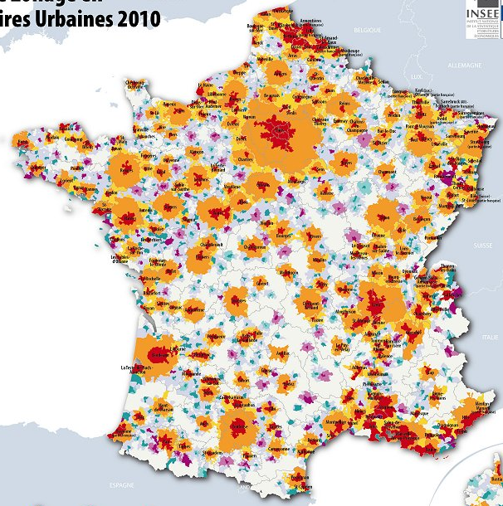
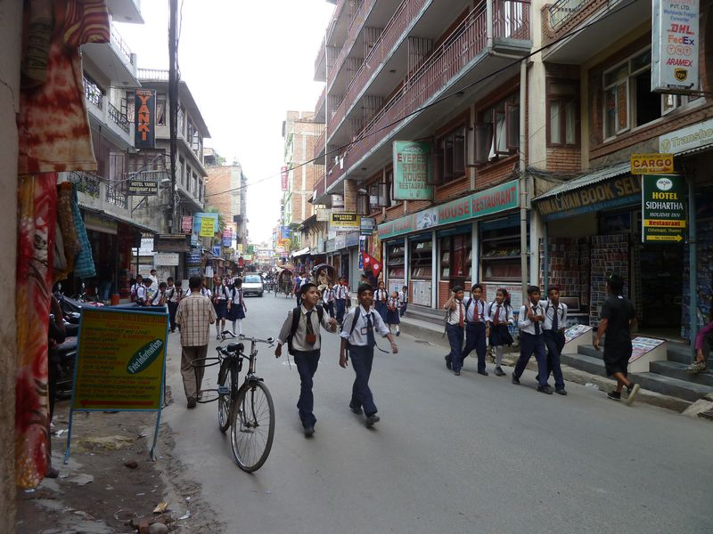
Introduction: Streets are important
Cities are important places
Many people live in it
World : 50% in urban area.
France : 80%
Concentrate people/power/usages/issues
Streets are important in cities
In Paris, streets area > building area
Streets = medium between people/occupations
insee

Slide 11

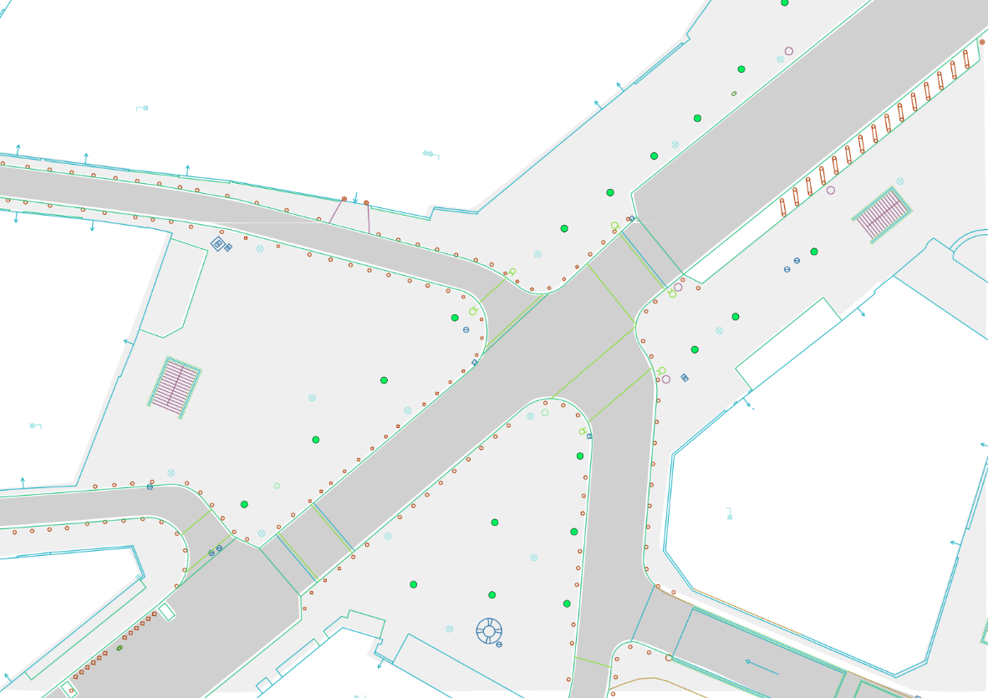

Introduction: Streets are important
Road axis, roadway vs Street
Open Data Paris

Slide 12
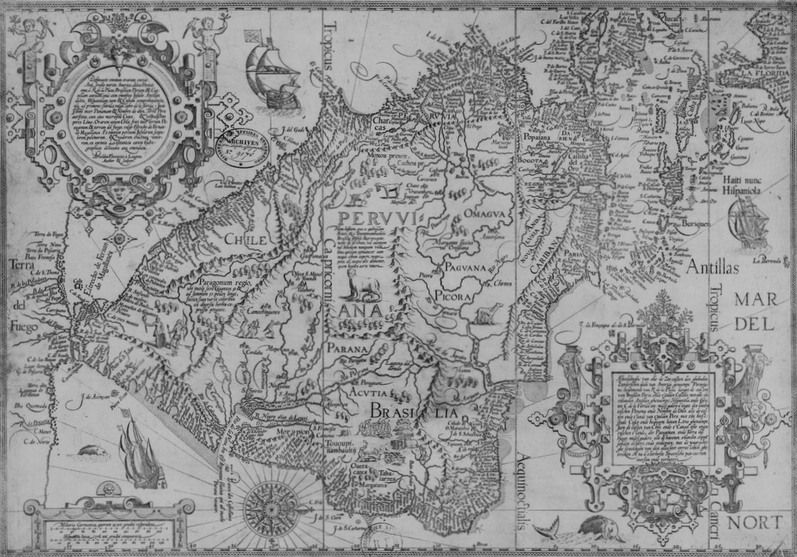

Introduction: having a model is important
Why would we want an accurate, structured, up-to-date map of streets?
Mapping = maps are classical control/management tools
Map war for South America (Madrid, 1750)
Mapping = visualising: very helpful for human
BNF, Gallica

Slide 13
Introduction
Why model streets?
Usages for street model

Slide 14


Introduction: usages for street model
Cities and streets are carefully managed
Paris : 100s of people, one dedicated engineer school
Requires data (precise, up-to-date)
Visualisation
Analysis
Simulation

Slide 15
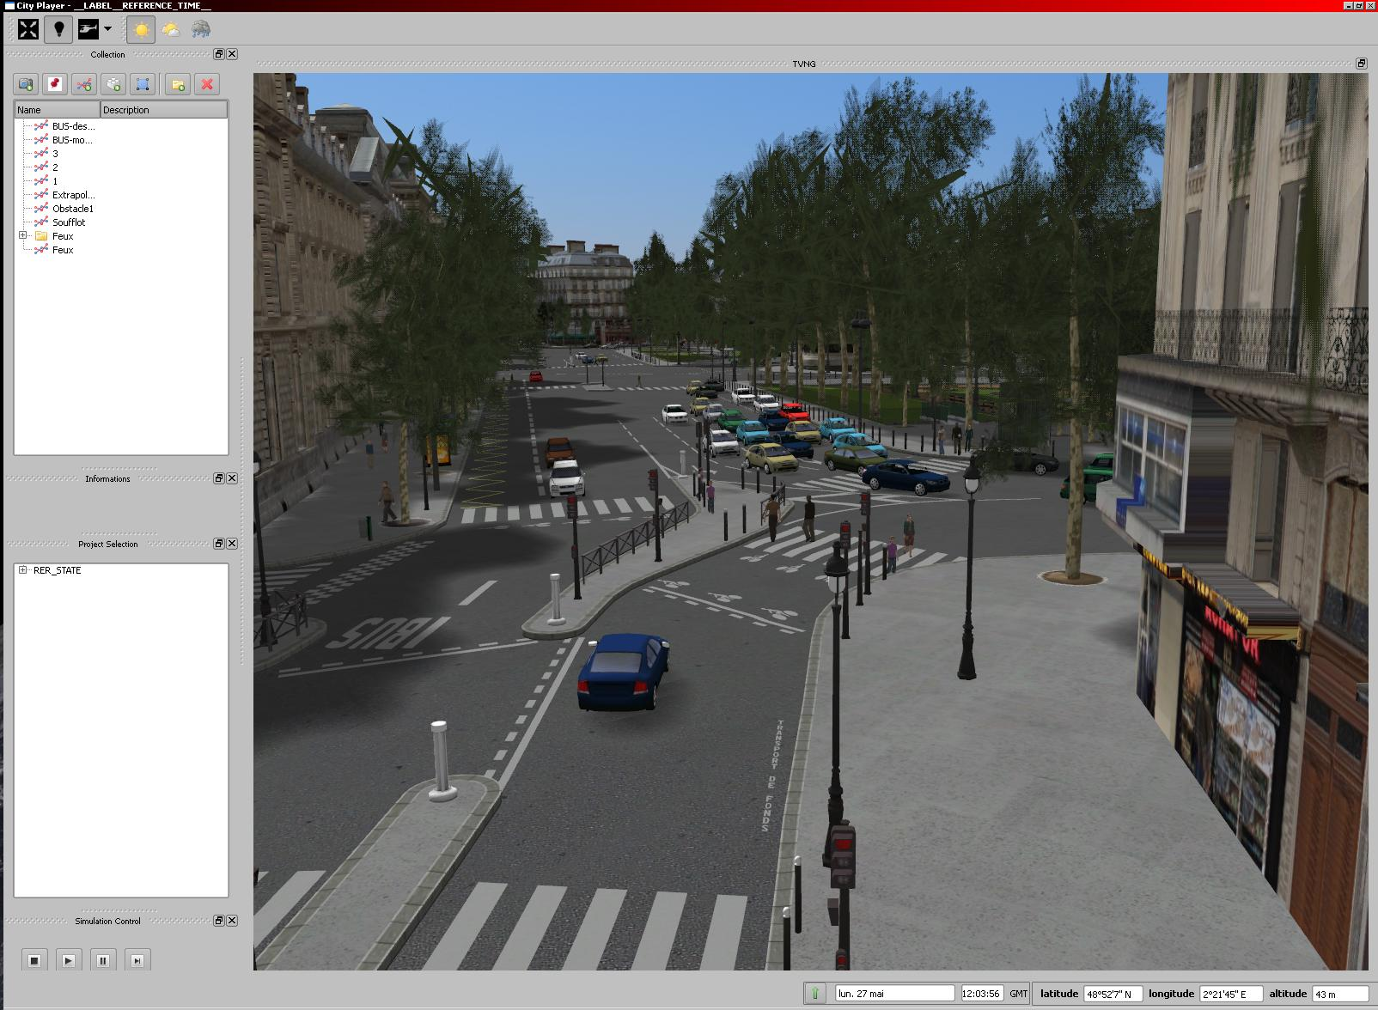

Introduction: usages for street model
Visualisation / analysis / simulation
Visualisation
map / 3D model
Consultation / communication
Thales TVNG

Slide 16
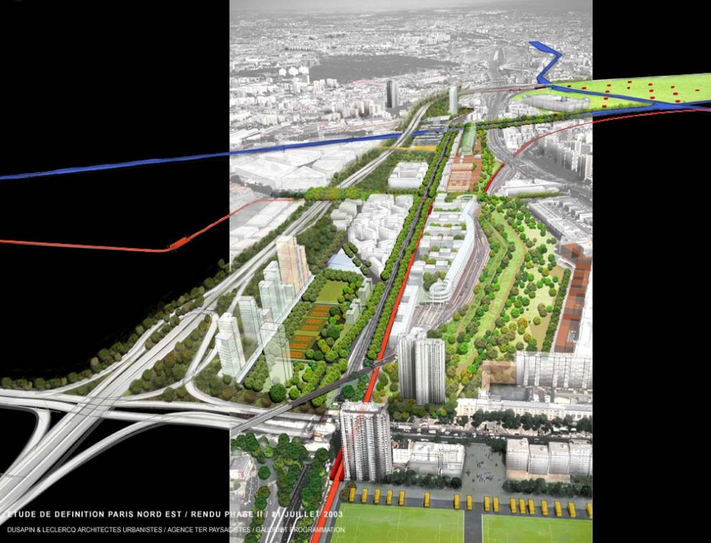
Introduction: usages for street model
Visualisation / analysis / simulation
Analysis
Past
Present
planning
Apur

Slide 17
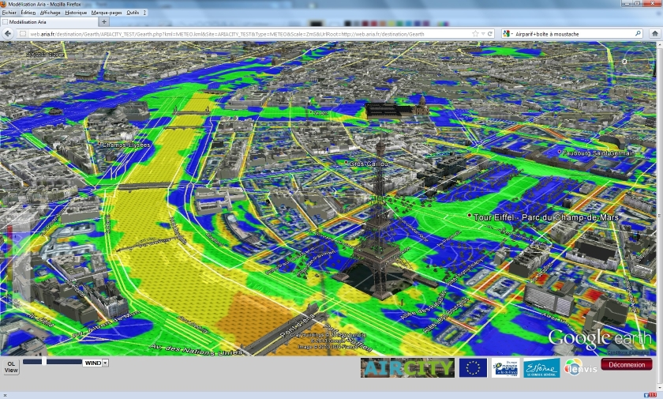
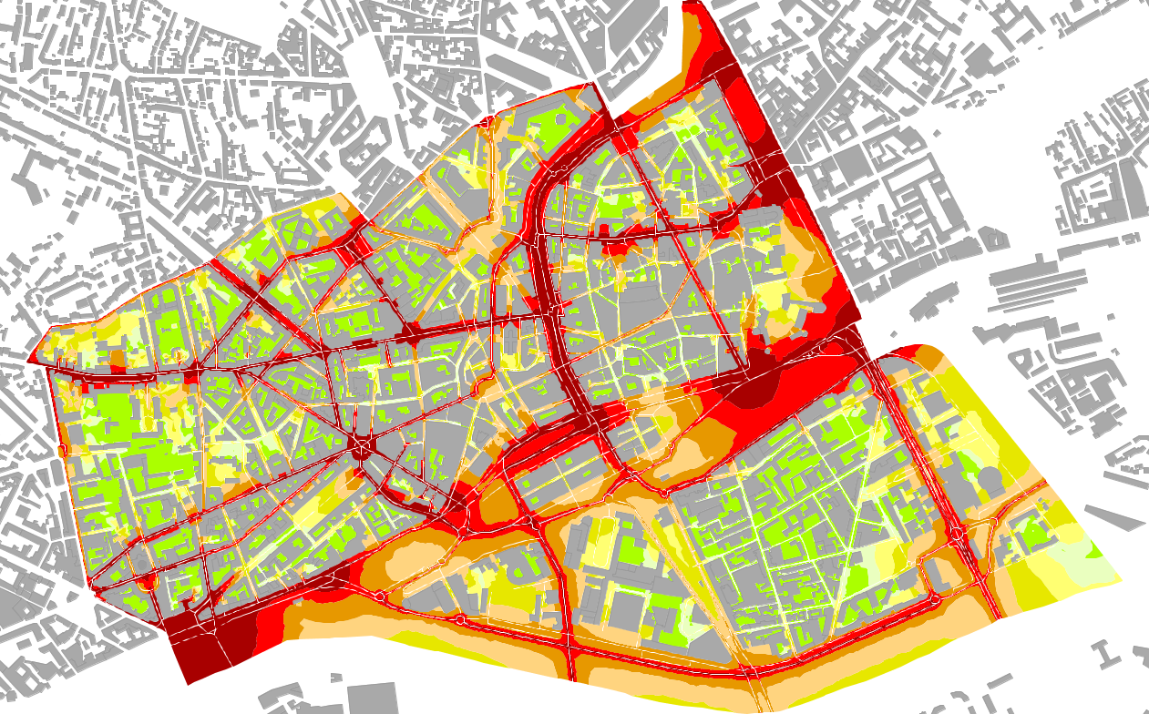
Introduction: usages for street model
Visualisation / analysis / simulation
Simulation
Traffic / pollution / noise …
Air city: pollution
Ifstar : noise

Slide 18
State of the art
Modelling street, why is it hard?
Existing methods

Slide 19
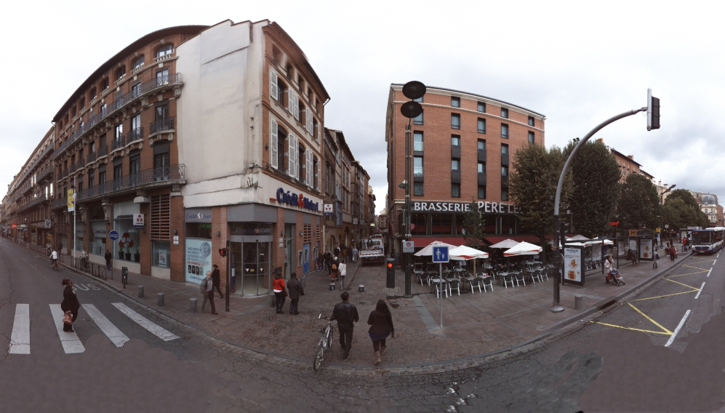
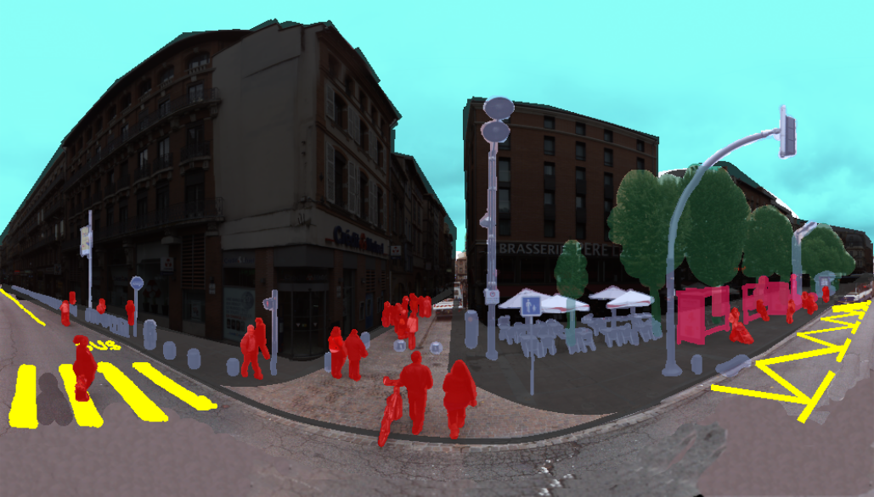
State of the art: modelling street is hard
Even « regular » streets are hard to model
Complex (even for human)
Traffic
Organised
Hard to sense

Slide 20
State of the art: modelling street is hard
complex / traffic / organisation/ sensing

Slide 21
State of the art: modelling street is hard
complex / traffic / organisation/ sensing

Slide 22
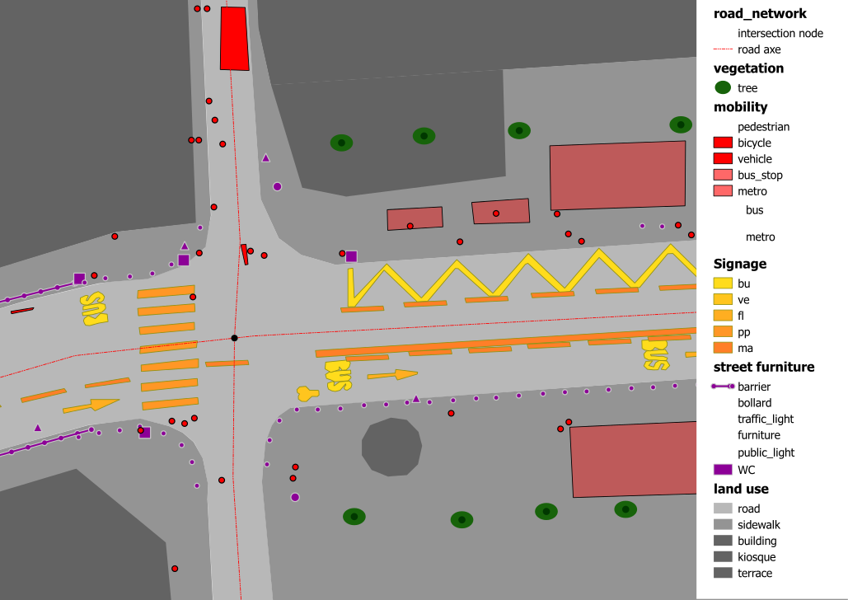
State of the art: modelling street is hard
complex / traffic / organisation/ sensing

Slide 23
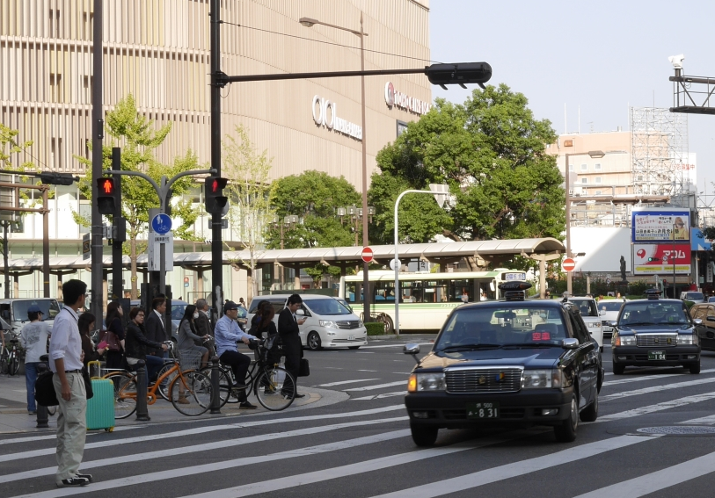
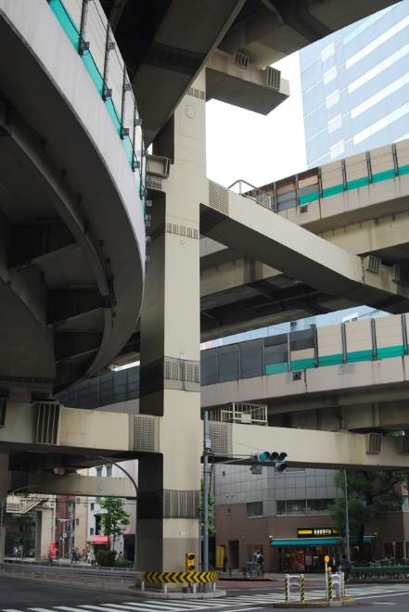
State of the art: modelling street is hard
complex / traffic / organisation/ sensing

Slide 24
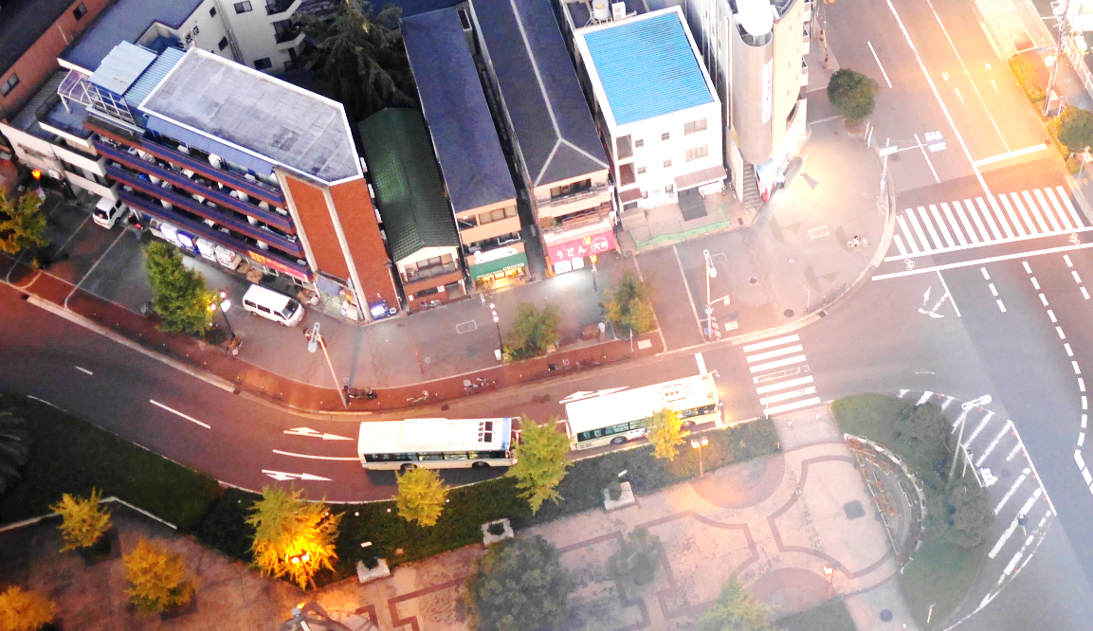
State of the art: modelling street is hard
complex / traffic / organisation/ sensing

Slide 25
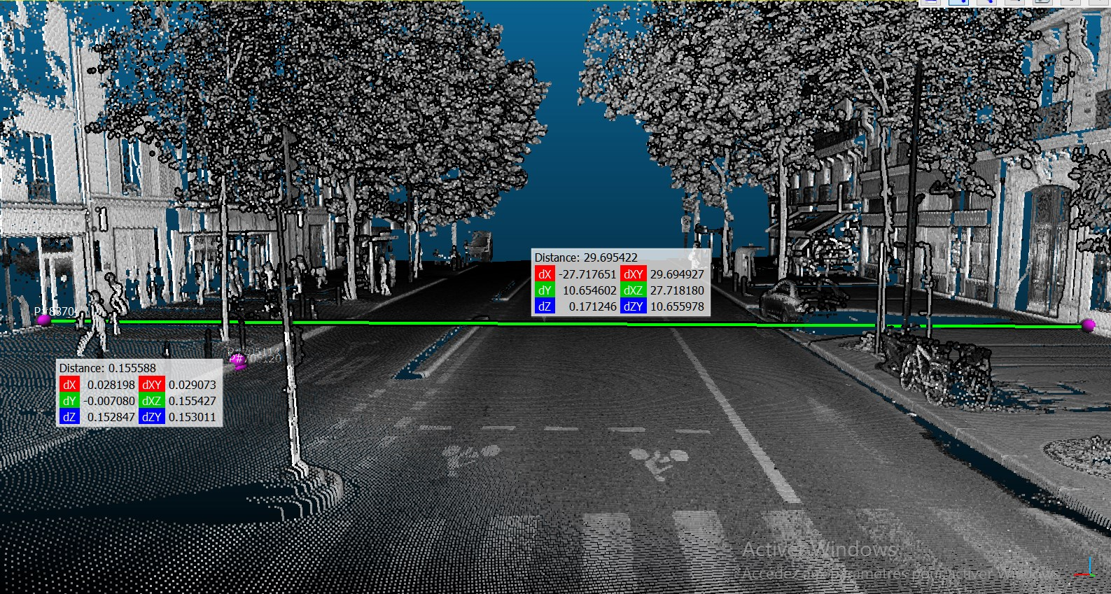
State of the art: modelling street is hard
complex / traffic / organisation/ sensing
Manual : millions of objects
Automatic :
high occlusion
Small details are crucial (curb)

Slide 26
State of the art
Modelling street, why is it hard?
Existing methods

Slide 27
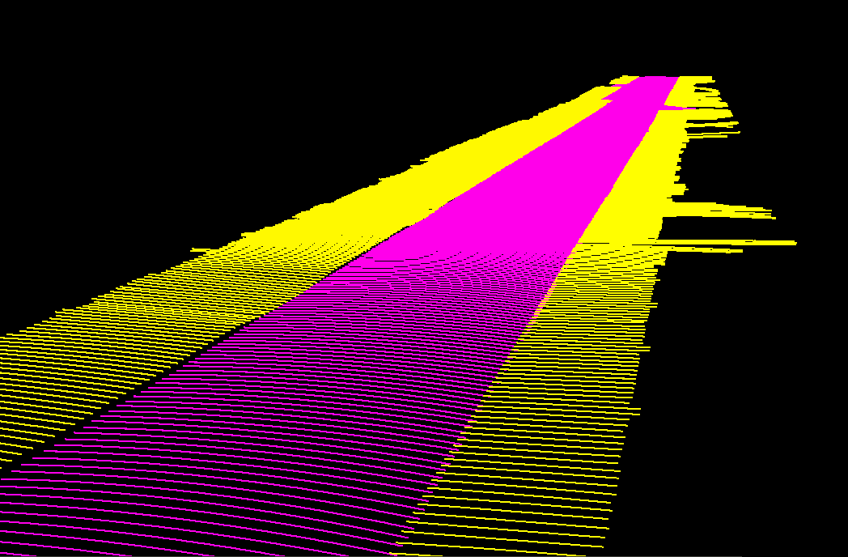
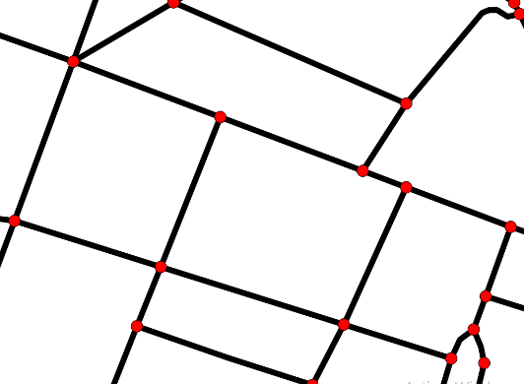
State of the art: Existing models
What « street» should be modelled?
street precise geometry (roadway/ sidewalk / …)
Street road as part of whole network (= traffic info)
Street objects
Material/visual aspects …

Slide 28
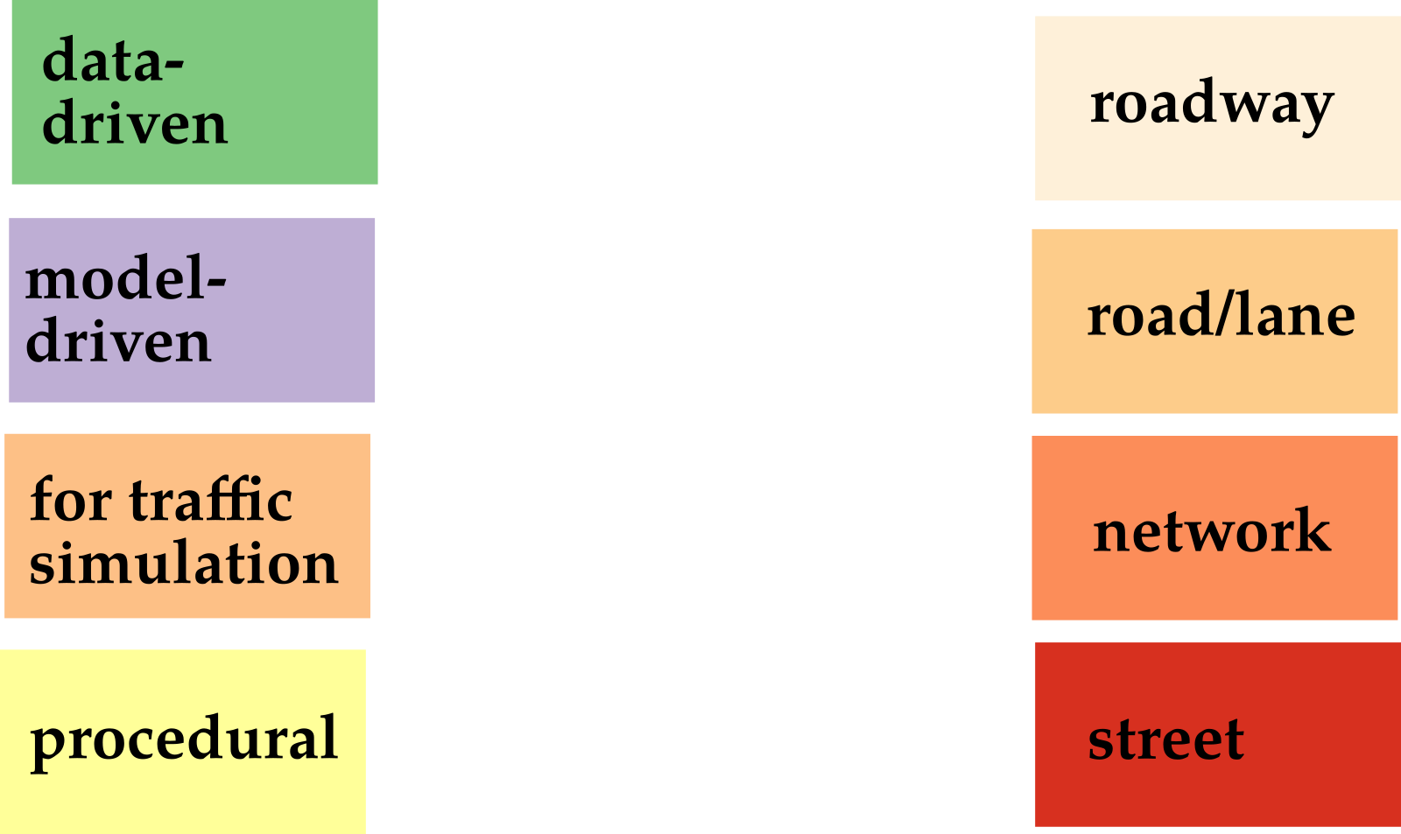
State of the art: Existing models

Slide 29
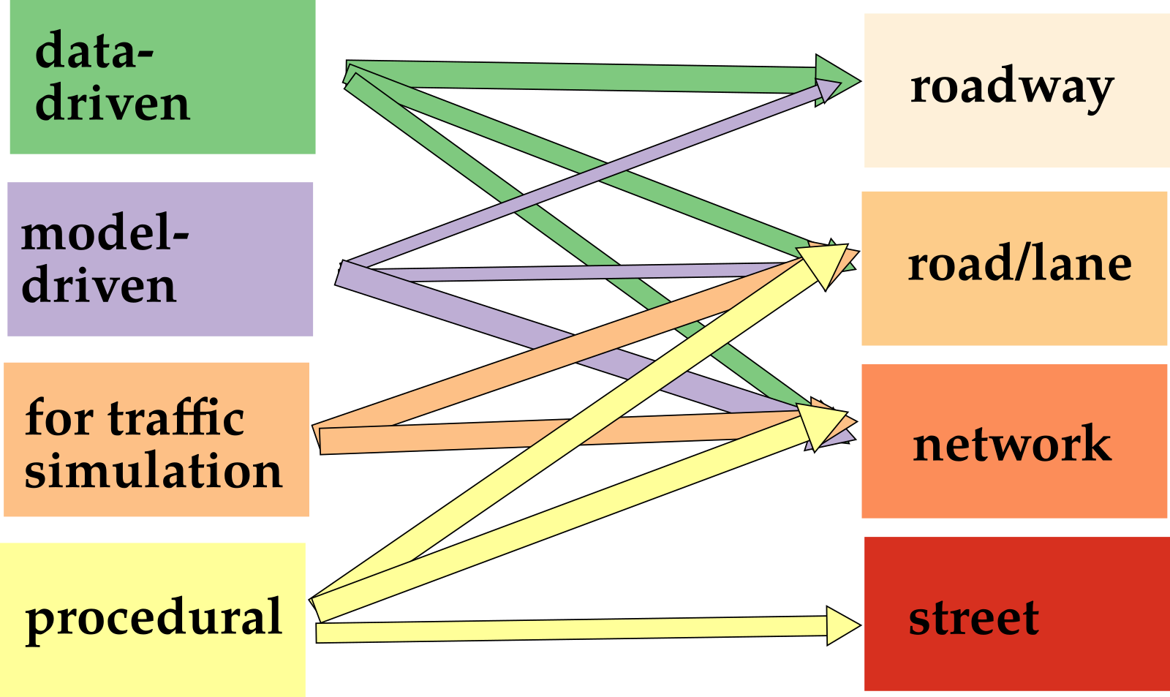
State of the art: Existing models
Guo2015
Boyko2011
Montoya2014
Fischler1981
Wilkie2012
Kuntzsch2015
Wang2015
Despine2011
Gallin2011
Chen2008

Slide 30

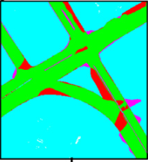
State of the art: Existing models
Data-driven / Model driven / traffic simulation / Procedural
Data-driven modelling
From lidar
Boyko2011
Guo2015
Extraction, raster, template matching
Fitting + active contour

Slide 31
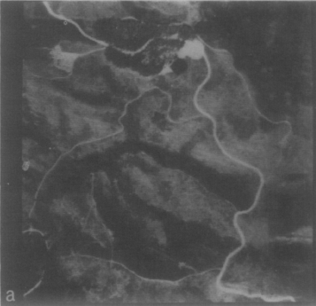
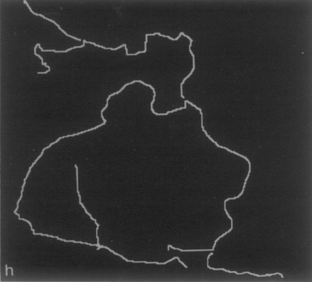
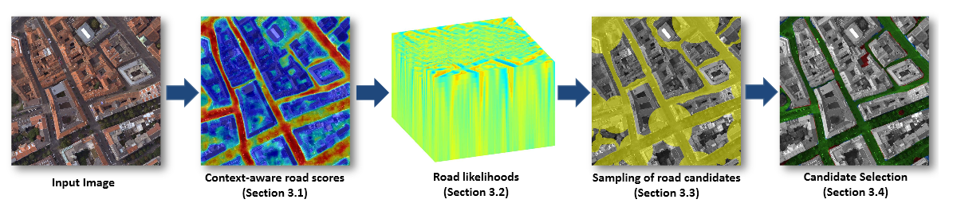
State of the art: Existing models
Data-driven / Model driven / traffic simulation / Procedural
Fischler1981
Data-driven modelling
From aerial images
Montoya-Zegarra2014
High prec low recall + low prec high recall + F* (includes cost)
Classif + Context + CRF

Slide 32
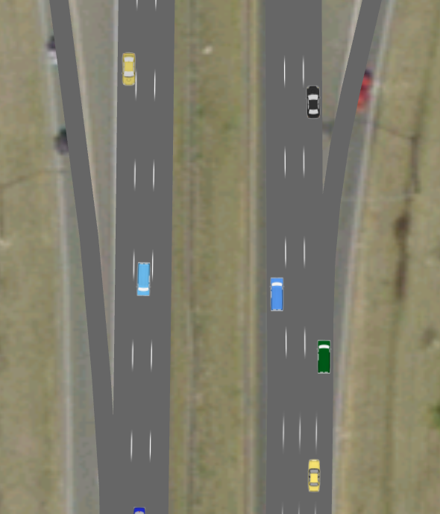
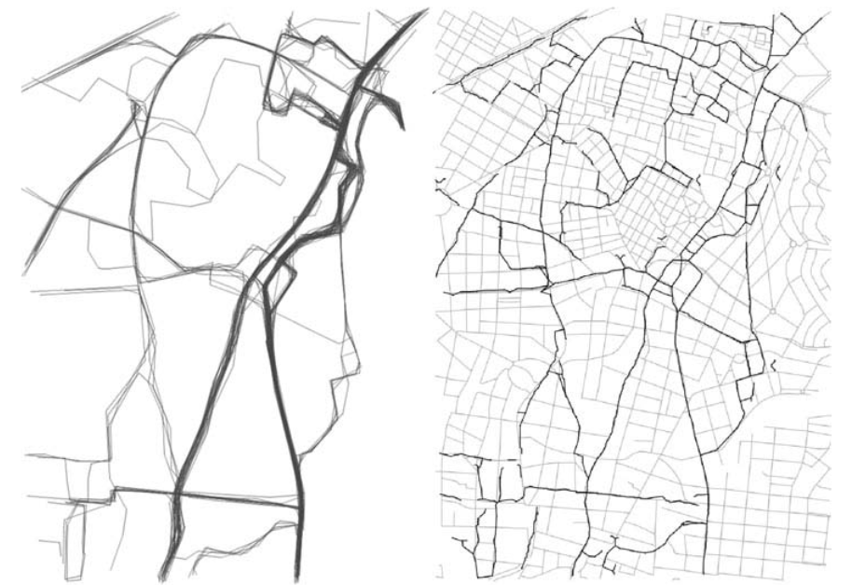
State of the art: Existing models
Data-driven / Model-driven / Traffic simulation / Procedural
Wilkie2012
GIS-based modelling
Kuntzsch2015
Street segment KDE, intersection with RJ-MCMC
Turning radius, network of lane, simulation

Slide 33
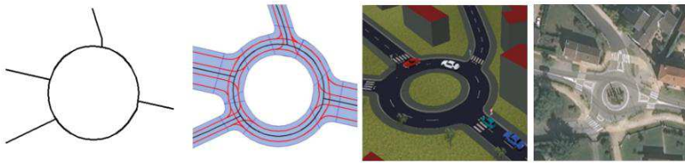
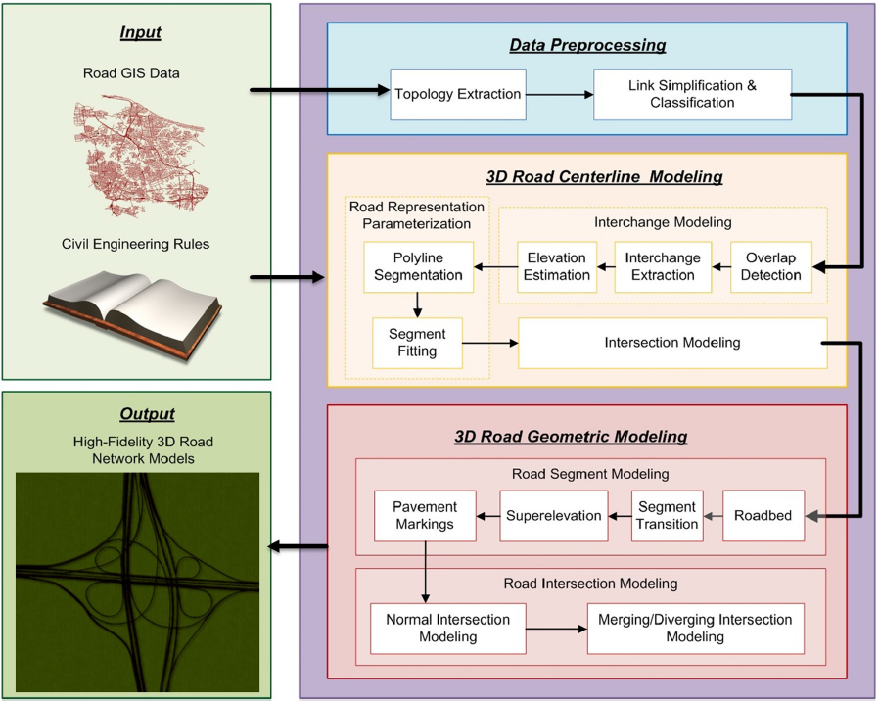
State of the art: Existing models
Data-driven / Model-driven / Traffic simulation / Procedural
Simulation-based modelling
Network from data, guessing lane, intersection by continuity, 3D generation
Despine2011
Wang2015
Segment of road parametrisation, intersection…

Slide 34
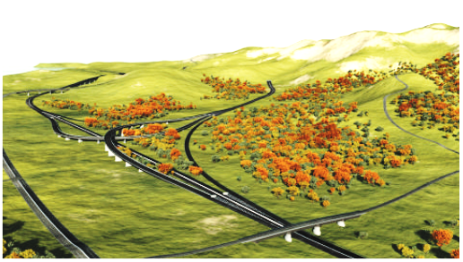
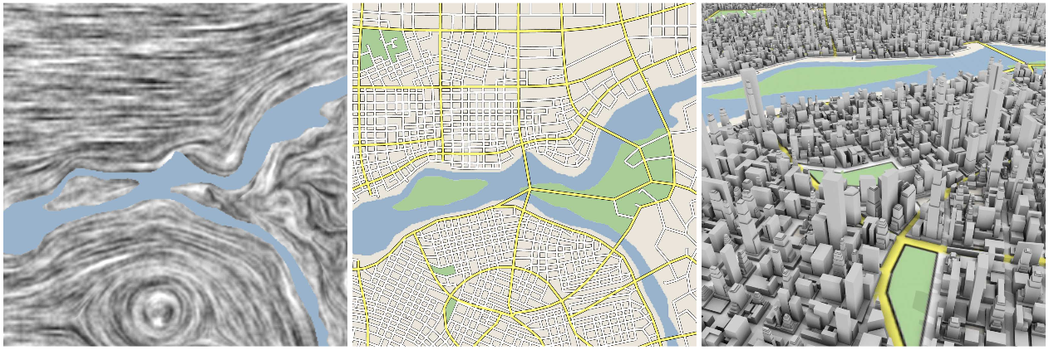
State of the art: Existing models
Data-driven / Model-driven / Traffic simulation / Procedural
Procedural modelling
Gallin2011
Chen2008
Tensor, stream line, grammar
Terrain, graph : shortest path and merging, procedural generation

Slide 35
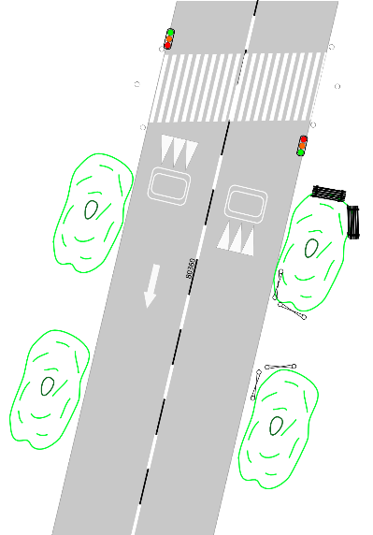
State of the art: Existing models
Our work

Slide 36
Abstract

Slide 37
StreetGen : generate streets
Design Principle
Kinematic hypothesis
Road surface
Traffic support
Street objects

Slide 38

StreetGen : design principle
Goals?
A generic, simple street model
Use it to model Paris streets
Model used for various outputs (analysis/ 3D visu / traffic simulation...)
Our approach:
based on road axis, use simple hypothesis to amplify
use a RDBMS (=database)

Slide 39
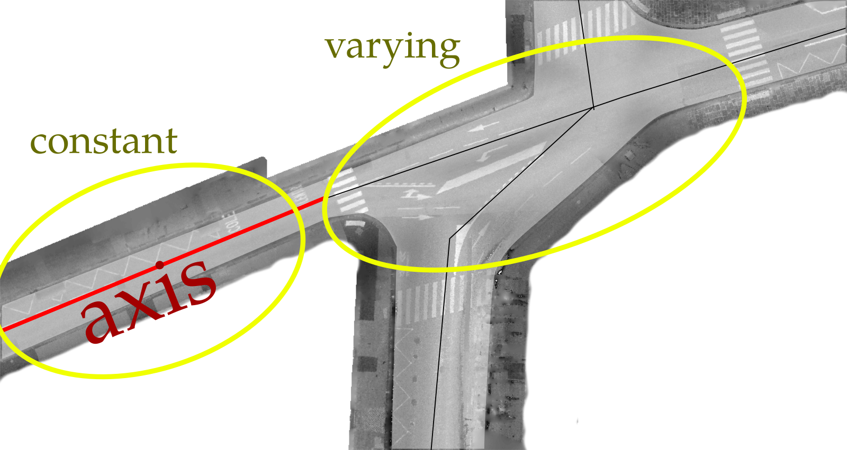
StreetGen : design principle
a model for most streets
Streets are : structured by axis |constant/varying

Slide 40
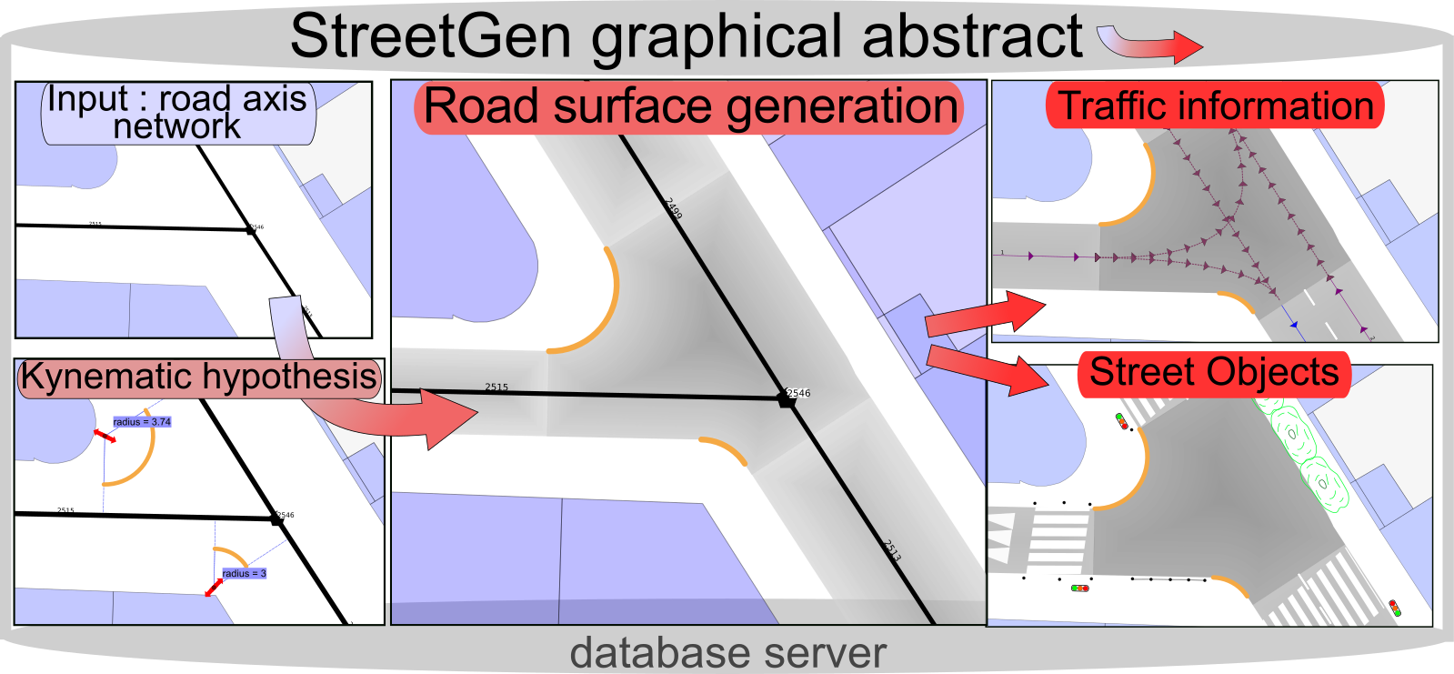
StreetGen : generate streets
StreetGen : graphical abstract

Slide 41
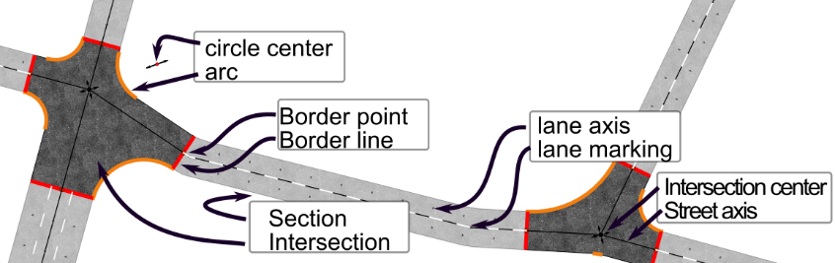
StreetGen : design principle
StreetGen road model:
axes + width + radius →circle center → section + intersection+ lane+…

Slide 42
StreetGen : design principle
Classical processing method:
Change? → redo everything
Several user → no sharing
Input data
Method
Output data (street model)

Slide 43
StreetGen : design principle
StreetGen :
input data + method + results in a database
Input data
User input
StreetGen
Road modeling

Slide 44




StreetGen : design principle
StreetGen : input data + method + results in a RDBMS(database)
Input data
User input
StreetGen
Road modeling

Slide 45
StreetGen : generate streets
Design Principle
Kinematic hypothesis
Road surface
Traffic support
Street objects

Slide 46
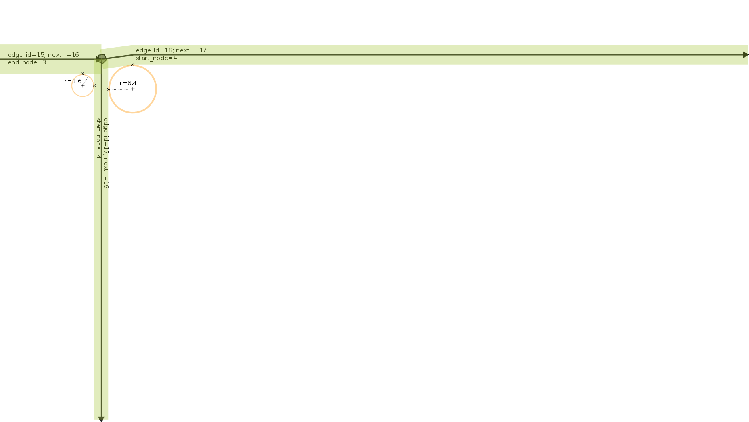


StreetGen : Kinematic hypothesis
Kinematic hypothesis
width
Road type
speed
radius
→
3m
9m
→

Slide 47
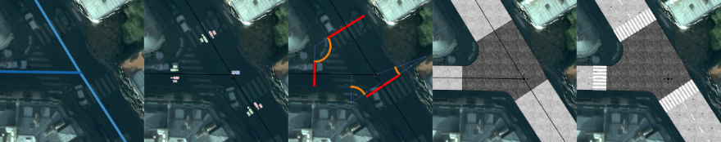
StreetGen : generate streets
Design Principle
Kinematic hypothesis
Road surface
Traffic support
Street objects

Slide 48
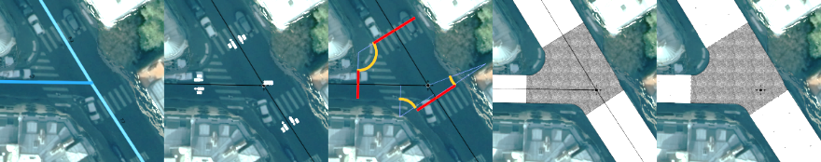
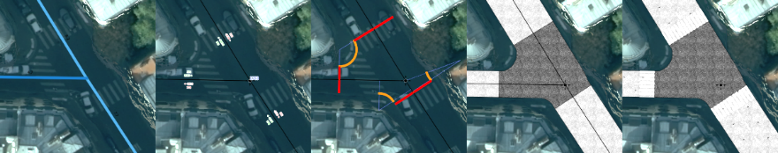
StreetGen : Road surface
t

Slide 49

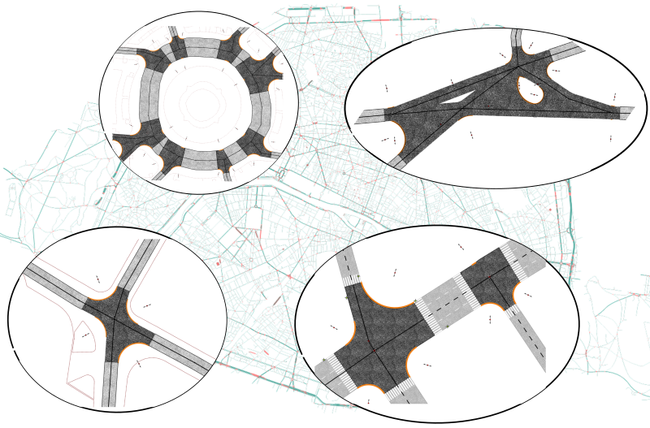
StreetGen : Road surface
Results:
Hypothesis OK
Robust
Generic

Slide 50
StreetGen : generate streets
Design Principle
Kinematic hypothesis
Road surface
Traffic support
Street objects

Slide 51
StreetGen : Traffic Support
For traffic simulation:
Lanes
Possible trajectories in interconnections.
Traffic simulation requires much more
Average speed
Type of intersection (roundabout/traffic light)
Etc …

Slide 52
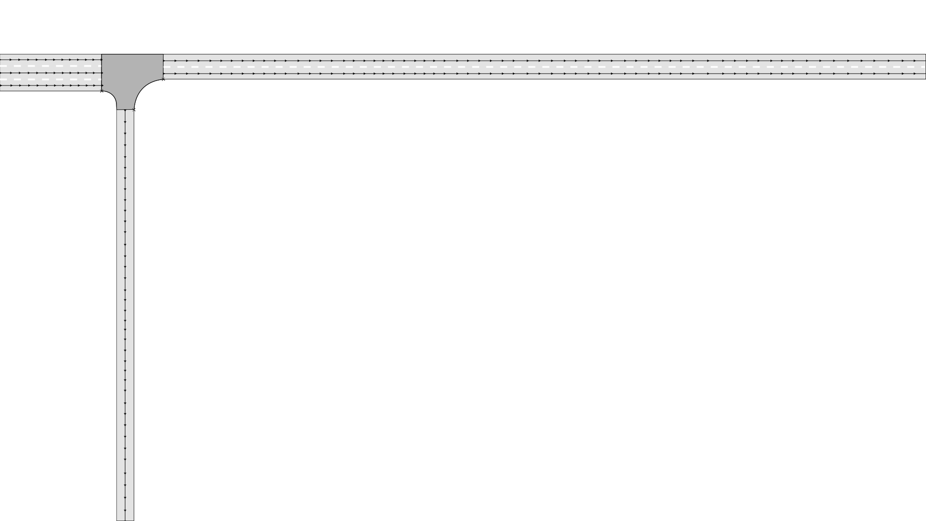
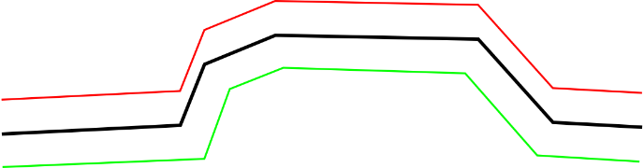
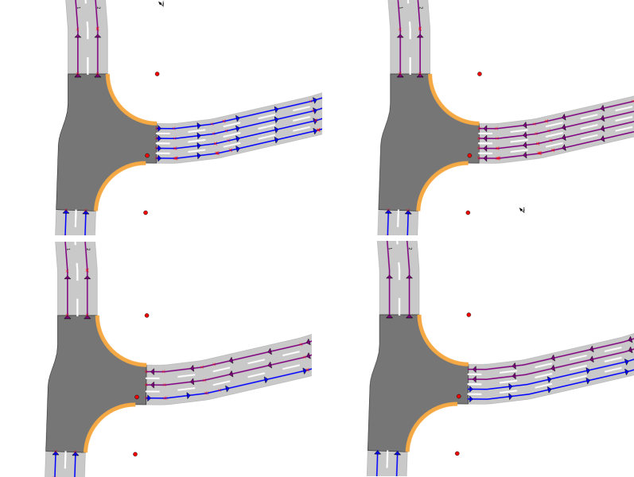
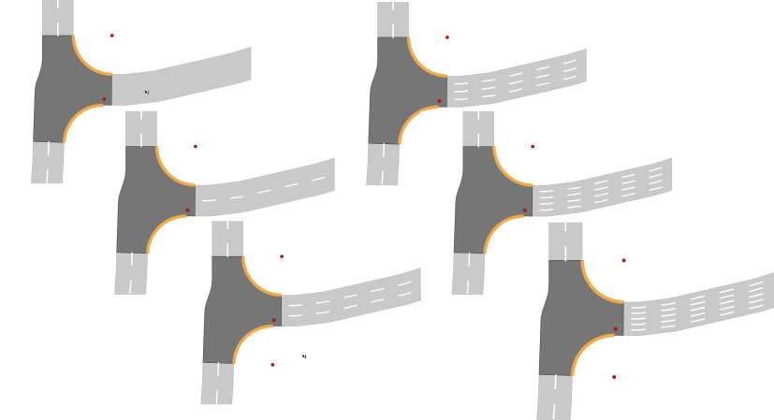
StreetGen : Traffic Support
Lane based on road axis : but not translation

Slide 53
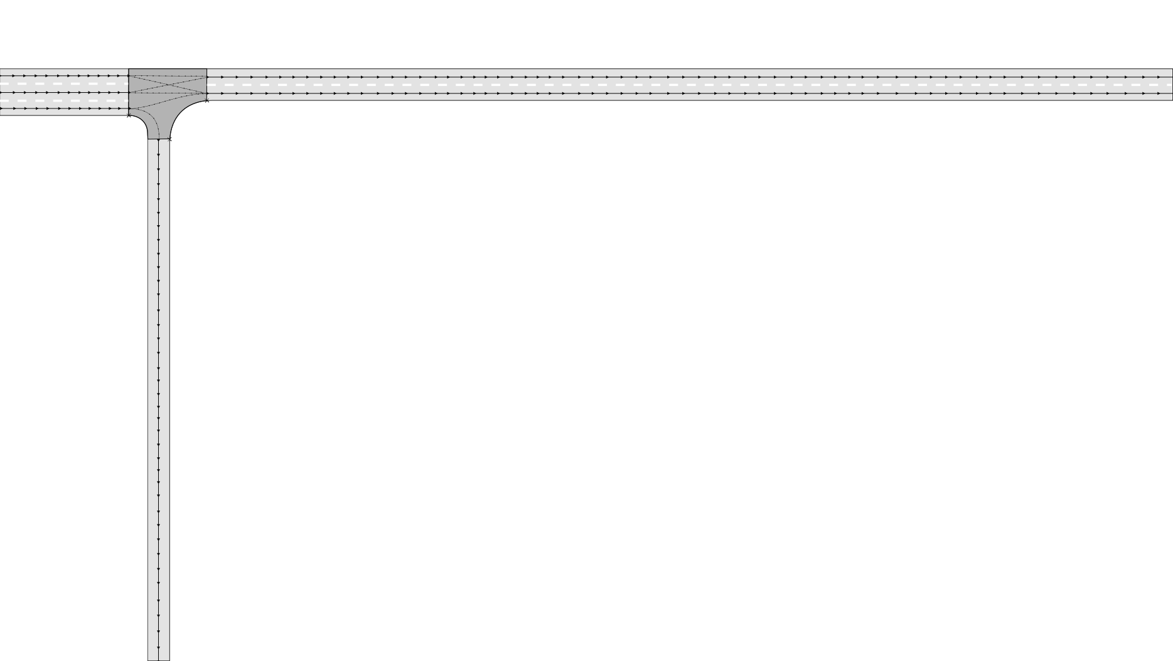
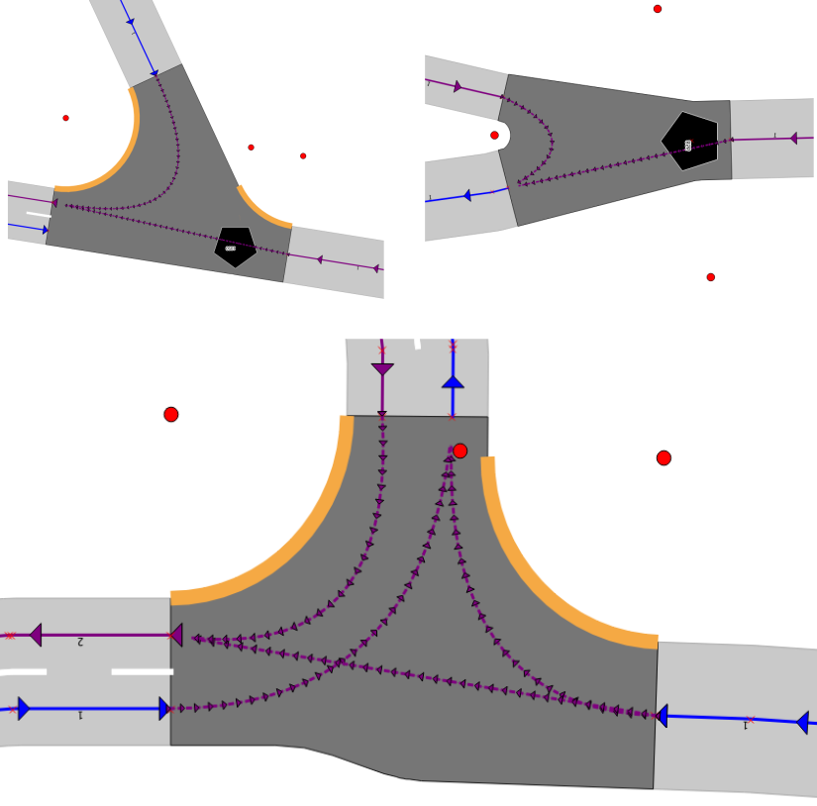
StreetGen : Traffic Support
Intersection trajectory : Bezier curves:
Not accurate (cinematically), but easy to create and edit
Involves center of intersection in special cases
Direction coherent with lane direction

Slide 54
StreetGen : generate streets
Design Principle
Kinematic hypothesis
Road surface
Traffic support
Street objects

Slide 55
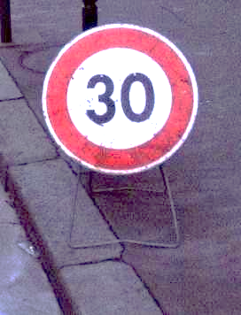




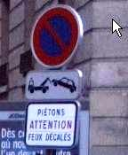

StreetGen : street objects
Streets objects : incredibly varied
13k references on www.ArchiExpo
Norms : « Instruction Interministérielle sur la signalisation routière » : 1000 pages
…
Objects are in relation (hierarchical, spatial, semantic …)

Slide 56
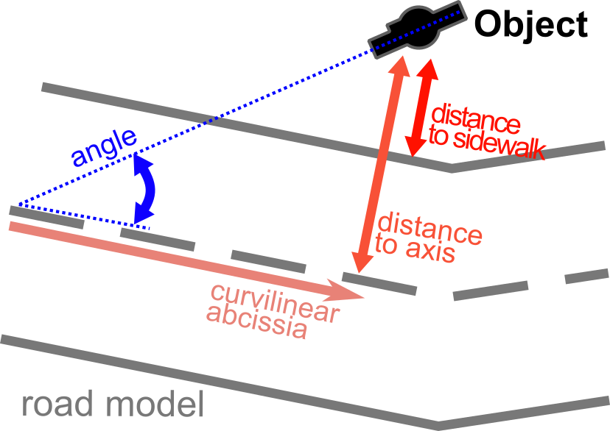
StreetGen : street objects
Street objects are often spatially organised (position and orientation) relatively to the street axis
So we use generic objects
Positioned/oriented relatively to street axis

Slide 57
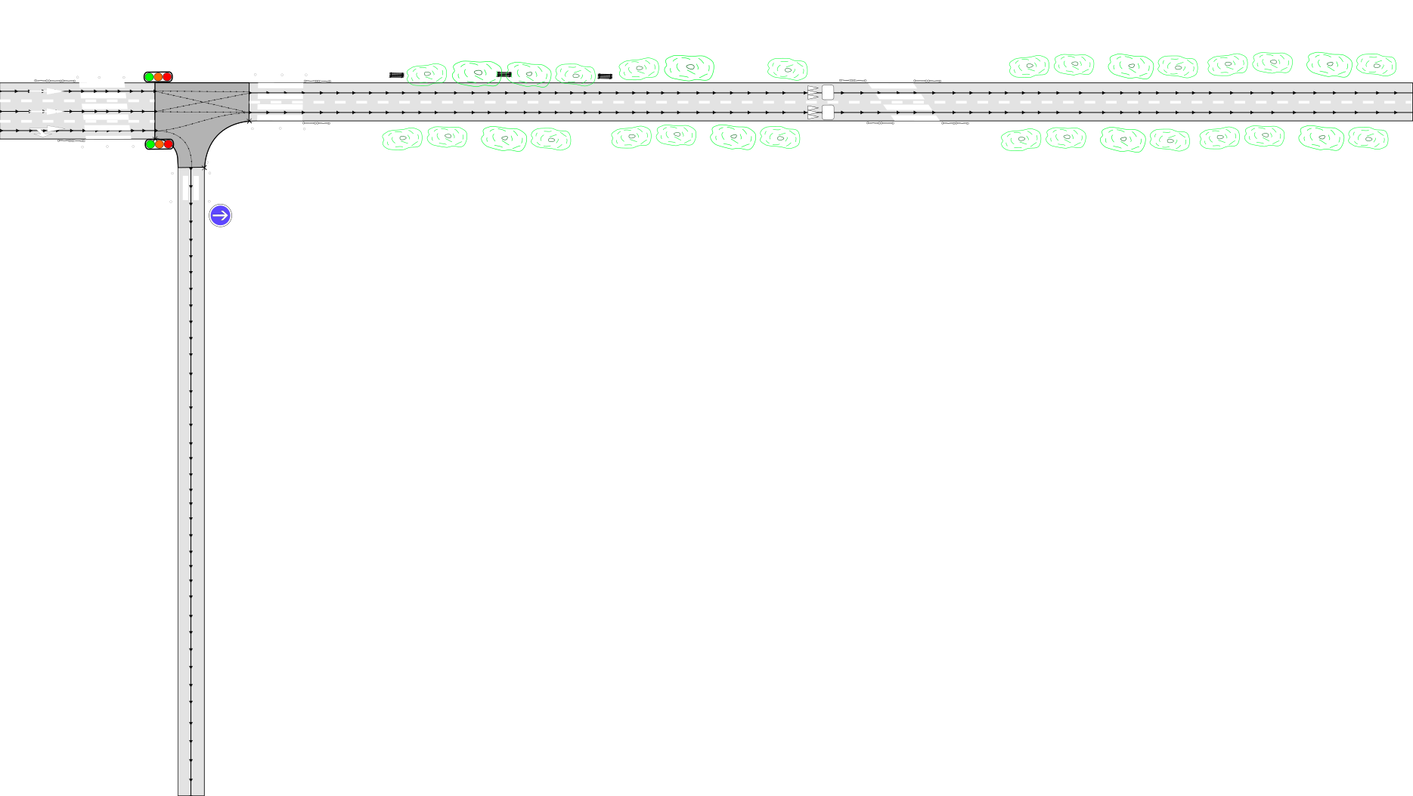

StreetGen : street objects
Objects are points with semantic
DBMS can support any relation (hierarchy, semantic…)

Slide 58

StreetGen : street objects
Also surface
Pedestrian crossing for instance

Slide 59
StreetGen
results

Slide 60

StreetGen : street objects
Model simple and generic
OK for most of streets
Whole Paris in 10 min (2’ //)

Slide 61
StreetGen : street objects
Tested for 3D visualisation
Thales NeoDBGS

Slide 62
StreetGen : street objects
Tested for simulation (SimuVia)

Slide 63


StreetGen : street objects
Tested to model other cities (West Africa)
Tested to model airport runway

Slide 64
StreetGen : street objects
Contributions
Data, method, result in RDBMS
Robust road surface computing
Fast (interactive for few streets) & scale well

Slide 65

StreetGen : street objects
Of course, lots of limitations
Street model:
Not enough for some street
Radius seems to be historical rather than related to speed
Technical
Precision issues
Objects
Lacks linear objects

Slide 66

StreetGen : street objects
Input data: not precise
For better results, need editing

Slide 67
Abstract

Slide 68
StreetGen : editing streets (in-base)
In-base interaction Principle
Edit road model
Edit traffic
Edit objects

Slide 69

StreetGen : street objects
How to edit street model easily?

Slide 70

StreetGen : street objects
Fact : Graphical User Interface (GUI) → hard
Many GUI for many tools (web/desktop/…)
Need to create plugins/interfaces/…
Use existing tools !
GIS tools can already edit vector and attributes
specific interactions are in base

Slide 71

StreetGen : street objects
example:
In GIS software
In base

Slide 72

StreetGen : street objects
In-base interaction are generic and powerful
Design pattern to help use it for other applications

Slide 73


StreetGen : street objects
All StreetGen street model can be edited concurrently
Road axis/ width/topology
Radius
Lane
Interconnection
objects

Slide 74
StreetGen : street objects
All StreetGen street model can be edited concurrently
Road axis/ width/topology
Radius
Lane
Interconnection
objects

Slide 75

StreetGen : street objects
All StreetGen street model can be edited concurrently
Road axis/ width/topology
Radius
Lane
Interconnection
objects

Slide 76

StreetGen : street objects
All StreetGen street model can be edited concurrently
Road axis/ width/topology
Radius
Lane
Interconnection
objects

Slide 77

StreetGen : street objects
All StreetGen street model can be edited concurrently
Road axis/ width/topology
Radius
Lane
Interconnection
objects

Slide 78

StreetGen : street objects
Results:
Interactions are fast enough to be interactive
Video
https://youtu.be/fQZoEfUcNHA

Slide 79


StreetGen : street objects
Results:

Slide 80
StreetGen : street objects
Contributions
New interaction paradigm
Works with any mapping framework
Generic : design pattern to manage interactions and user input
Concept of geometric interactors

Slide 81

StreetGen : street objects
Several Limitations
limited to straightforward interaction (guessing user action is easy)
Old school : Hard to develop/test/maintain
one transaction → should be short
Objects: relative positioning may be ambiguous

Slide 82
StreetGen : street objects
Manual fitting : we can come close to real streets
Tedious
Lengthy !
Can we teach the machine to do it for us?

Slide 83
Abstract

Slide 84
Automating street modelling
Inverse procedural modelling concept
Street objects observations
Fitting principle
Results

Slide 85








StreetGen : Inverse procedural modelling
Inverse Problem:
Procedural model
observations
Model = C(3.2,2.1,1.5)
fit
→
+
Image : Three-dimensional modelling and visualisation of vegetation for landscape simulation
Thales: Building maker

Slide 86


StreetGen : Inverse procedural modelling
Wan2012
Fit a generic procedural model to a specific situation
Specific situation?
→ We need data!
observations
Talton2011
observations

Slide 87
StreetGen : Inverse procedural modelling
In this work:
Procedural model = StreetGen for road
Observations = any street object
from other works

Slide 88



Inverse Procedural modelling: method
Initial road model (⊂ StreetGen) + observation
Observations = any street object detection
observations

Slide 89

Inverse Procedural modelling: method
Initial road model + observation→ fitted road model

Slide 90
Automating street modelling
Inverse procedural modelling concept
Street objects observations
Fitting principle
Results

Slide 91
StreetGen : Inverse procedural modelling
To fit, we need observations describing street.
Where from?

Slide 92

StreetGen : Inverse procedural modelling
What type of data for streets?
Precise
Good coverage
Frequent
Aerial image?
Good coverage
Low 3D precision

Slide 93
StreetGen : Inverse procedural modelling
IGN dedicated mobile mapping: Stereopolis
Cameras
Lidar

Slide 94

StreetGen : Inverse procedural modelling
Street view:
Good coverage

Slide 95

StreetGen : Inverse procedural modelling
Lidar: 3D point clouds
precise 3D

Slide 96

StreetGen : Inverse procedural modelling
Soheilian 2012
Observations are detected street objects.
Street object have an expected position.
Pedestrian crossing:
Within the roadway!

Slide 97


Inverse Procedural modelling: forces
Each street object type has an expected position:
IN/OUT + BORDER_IN/BORDER_OUT (dist)
IN
BORDER OUT

Slide 98


Inverse Procedural modelling: observations
Observation = clues about roadway
We rely on other’s work:
(We can use any street object detection)

Slide 99

Inverse Procedural modelling: observations
Observation = clues about roadway

Slide 100
Automating street modelling
Inverse procedural modelling concept
Street objects observations
Fitting principle
Results

Slide 101

Inverse Procedural modelling: forces
Mechanical analogy:
Each observation push/pull road model

Slide 102
Inverse Procedural modelling: forces
they may be residuals errors! (observations are un-precise)

Slide 103

Inverse Procedural modelling: method
Real data :
Some bad observations
Need restraint

Slide 104

Inverse Procedural modelling: forces
resisting changes :
Conservative forces
express confidence in initial road model

Slide 105


Inverse Procedural modelling: experiment
Optimisation = Non-linear least square
→ no guarantee to find the global optimal solution, robust, very fast
Open source : Ceres solver
Areas of experiment:

Slide 106


Inverse Procedural modelling : small area

Slide 107

Inverse Procedural modelling : small area

Slide 108

Inverse Procedural modelling : small area

Slide 109


Inverse Procedural modelling : small area

Slide 110


Inverse Procedural modelling : small area

Slide 111
Inverse Procedural modelling : small area
Using Only kerb observation:
Median dist to Open Data Paris sidewalk :
from 1.8m → 0.4m (with user input: 0.34m )
It’s much better, robust and fast (50ms)!

Slide 112

Inverse Procedural modelling : sensing area
Whole sensing area:
Results:
Looks ok, but,

Slide 113

Inverse Procedural modelling : sensing area
Not enough observations!
Yellow circles are proportional to error:
Median dist : from 1.5 m → 0.6 m
→ it’s still way better

Slide 114

Inverse Procedural modelling : Paris area
Whole Paris with Open Data Paris (Ideal data) : works but :
topology is broken at few points
About 0.5%
→ manual corrections
from 1.5m → 0.1m

Slide 115
Inverse Procedural modelling: Streetgen on optim
Once simple road model is optimised, we can generate streets with StreetGen

Slide 116

Inverse Procedural modelling: Streetgen on optim
Streetgen after optimisation

Slide 117

Inverse Procedural modelling: Streetgen on optim
Traffic information is generated (but has not been optimised)

Slide 118

Inverse Procedural modelling: error sources
Residual errors sources

Slide 119
Inverse Procedural modelling: Limitations
Contributions:
Inverse procedural road modelling at city scale
Fast (few roads = interactive) and robust
Generic observations formulation: can work with any object observation

Slide 120
Inverse Procedural modelling: Limitations
Limitations
Only optimising a simplified road model (no radius, lanes, etc.)
Road model is too simple
Must choose between trusting initial model and trusting observations
Lacking regularisation forces for width (propagation)

Slide 121
Abstract

Slide 122
Point Cloud Server: Data for observations
Short introduction to Lidar
Point Cloud Server

Slide 123

StreetGen : Inverse procedural modelling
Demo Live mobile mapping Lidar (Velodyne)

Slide 124
Data for observations: Point Cloud Server
Short introduction to Lidar
Point Cloud Server

Slide 125



Point Cloud Server
Point Cloud Server : manage massive amounts of geospatial point clouds in a database.
Many types of geospatial point clouds
Terrestrial LIDAR
Medical
imaging
Aerial LIDAR
Stereovision

Slide 126
Point Cloud Server: Problems
Problem:
Massive data → need
Sharing
Filtering
Efficient I/O
Compression
Point cloud != only processing
We need a service!

Slide 127
Point Cloud Server: State of the art
Otepka et al., 2013
File-based
Simple, no concurrency
Can’t do much with points
DBMS (point storing)
Powerfull
Can’t scale
NoSQL
Scale well
Specific and tailored
Cloud
Ultimate scaling
Theoretical problem with indexing
DBMS (group of points storing)
All inclusive
Points need to be group-able
Rieg et al., 2014
van Oosterom et al., 2015
Todo : simplify, images
Managing billions of nD-points : difficult !
Greyhound
≠
Managing millions of groups of points: easy!

Slide 128

Point Cloud Server: Method
Idea:
PCS = a … server !
Point Cloud Server
File system
Many interfaces
possible
Abstraction
safe
RDBMS

Slide 129

Point Cloud Server: Method
Workflow

Slide 130


Point Cloud Server: Loading/Exporting
Paris
Terrestrial lidar
2.15 B points
750 ply files
42 linear km
21 attributes
Typical resolution: 1 cm

Slide 131

Point Cloud Server: Loading/Exporting
Paris loading speed: 75k pts/s writing : 200k pts/s
Not far from actual sensing speed
Could be faster (Vanoosterom2015)
We load point clouds, but how are they stored?

Slide 132

Point Cloud Server: generalisation
Group of points (aka patch) generalisation
Generalisation = abstraction

Slide 133
Point Cloud Server: generalisation
Other generalisation
Essential : abstracting the data = more abstract usage
Ex : points within flat neighborhood vertical VS points in a wall
Top view in QGIS

Slide 134


Point Cloud Server: processing
More generalisation

Slide 135

Point Cloud Server: filtering
With so much data:
Essential to access only a part of it : example
Patches that are
far from buildings
close to the intersection of these 2 streets
aerial view color ≈ pedestrian crossing
close trajectory
with high point density

Slide 136






Point Cloud Server: filtering
Result : finding millions of points amongst billions :
100 ms if indexed !
points
Points in patch
Which points are inside the polygon?
Which patchs are inside the polygon?
Get points in these patches
Which points are inside the polygon?
?

Slide 137



Point Cloud Server: processing
Postgresql: easy to add in-base processing
C/Cpp → for performance
R/Python → for fast prototyping
Example :
Verticality descriptor
Unsupervised clustering
Plane & cylinder detection

Slide 138










Point Cloud Server: processing
Converting patch to raster
Cornerstone detection
Marking detection
Façade detection

Slide 139

Point Cloud Server: processing
classification

Slide 140

Point Cloud Server: processing
Patches can be used in a graph structure

Slide 141

Point Cloud Server: Level Of Detail
Level Of Detail (LOD):
Sometimes you don’t need all the points
12 Millions points, really?
User needs only a given Level Of Detail.

Slide 142

Point Cloud Server: Level Of Detail
Idea : implicit LOD
order the point by importance
Reading the points gradually increases the level of detail

Slide 143






Point Cloud Server: Level Of Detail
Example

Slide 144


Point Cloud Server: Level Of Detail
LOD enables point streaming
Paul Blottiere

Slide 145

Point Cloud Server: Level Of Detail
Also for classical GIS soft that can’t deal with too many points

Slide 146

Point Cloud Server: Level Of Detail
Contributions
PCS
Focus on the whole management problem, easy to use
Very advanced filtering
Easy processing: toward point cloud as a service
LOD
Implicit: simple and efficient
Easy to use in other settings
Demonstrating point cloud streaming: toward p.c. as a service

Slide 147
Point Cloud Server: Level Of Detail
Limitations
Points have to be group-able
Our Loading/export could be much faster
Filtering is fast at patch level, not point level
LOD : relies on ordering the points !
You have to use it
May be slow to build
For the moment, getting a part of the patch requires reading it entirely

Slide 148
Conclusion
Summary
Limitations
Perspectives

Slide 149
Conclusion: Summary
From low information: generate best guess street model at Paris scale and edit it (multi-user, using many GIS software): StreetGen

Slide 150
Conclusion: Summary
Perform inverse procedural modelling by fitting a road model to various observations

Slide 151
Conclusion: Summary
Manage a massive amount of 3D points (from mobile mapping). Act as a service for usage/processing/visu: Point Cloud Server

Slide 152
Point Cloud Server: Level Of Detail
Contributions
StreetGen
Simple model, everything in database
Interaction
Easy edit with any GIS soft
Optimisation
Optimise at whole paris scale, works with any observation
Point Cloud Server
Manage point cloud, point cloud as a service

Slide 153
Conclusion
Summary
Limitations
Perspectives

Slide 154
Conclusion: Limitations
StreetGen
Model too simple
Interaction limited to simple mechanisms
Optimise only a part of the model
Point Cloud Server :
Must group points into meaningful groups
Objects are created/edited manually by user
Tedious, not much sense

Slide 155
Conclusion
Summary
Limitations
Perspectives

Slide 156
Conclusion: Perspectives
Only the beginning of inverse procedural street modelling.
Object should be created by template/ pattern/ grammar/procedural functions!
Dealing with objects and road model simultaneously calls for much stronger modelling and optimisation methods
Optimisation should be more powerful (RJ-MCMC)
im
im

Slide 157
Conclusion: Perspectives
Major trend in smart vehicle/autonomous cars
→ maps potentially required by every (Billion) cars
For the moment: low level information, but
All cars will need a shared high level road model
im
im

Slide 158
Conclusion: Perspectives
Cities are evolving
There are several cities in one city:
Café terrace: day/night
Garbage bin
(parking behaviour)
Time is essential (simulation/understanding)
4D street modelling ?
im
im

Slide 159
Conclusion: Perspectives
To understand city evolutions→study city history
Historical geodata
Hand drawn maps
Information needs to be extracted
(my current work)
im
im

Slide 160

Conclusion: Perspectives
Jacoubet, 1810-1836 :
road model with optimisation & Streetgen ?

Slide 161



Conclusion: Perspectives
Extract building number, buildings limits, street surface (B. Vallet)

Slide 162

Conclusion: Perspectives
Turgot, 1734-1739 : isometric persp.

Slide 163

QUESTIONS
Thanks
Questions?

Slide 164
TODO
Conclusion need illustrations and splitting slides
Solve the todo

Slide 165
notes
Premiere page: logos en gros

Slide 166
notes
- le besoin de réduire l'information pour pouvoir passer plus de temps à expliquer certains schémas
- le besoin de fluidifier certaines transitions (notamment la transition nécessaire vu que le Point Cloud Server se retrouve à la fin)

Slide 167
appendix
annexe

Slide 168



State of the art: Existing models
System / GIS / Simulation / Procedural / Data-driven
Whole system modelling
City GML : for city, but contains a road module
Road XML : oriented for traffic simulation
Open Drive : high geometric details

Slide 169
StreetGen : Kinematic hypothesis
Todo bonus: schema XML

Slide 170
Introduction: usages for city model
Street model ⊂ city model
Many usages for a city model
Urbanism
Transport
Environment
Security
Communication
…

Slide 171

StreetGen : Kinematic hypothesis
We have road axis, road width
How to compute circle center and arcs?
analytical computing (vector, angle) ?

Slide 172

StreetGen : Kinematic hypothesis
Various radius in Paris

Slide 173

StreetGen : Kinematic hypothesis
t

Slide 174


StreetGen : Road surface
Find intersection limit :
Project circle centers
Farthest per axis

Slide 175



StreetGen : Road surface
Create Intersection surface :
By geometric operation

Slide 176



StreetGen : Road surface
Special intersection:
Variable buffer
No other parameter for road width reduction control

Slide 177


StreetGen : street objects
Multi-user editing can be facilitated
“Interactive Map Tracking” QGIS plugin with Lionel Atty

Slide 178

StreetGen : Kinematic hypothesis
Real example of interactive map tracking usefulness

Slide 179

Inverse Procedural modelling: forces
Each type of street object expected position is defined in a table

Slide 180

Inverse Procedural modelling: forces
Observations generate forces on road axis/width
Each street object type has an expected position:
IN/OUT + BORDER_IN/BORDER_OUT + dist

Slide 181

Inverse Procedural modelling : matching
Observations generate force on road axis/width, But first :
Observation ←matching→ road axis:
Closest road surface

Slide 182

Inverse Procedural modelling: matching
In intersections : can’t use observations:
We would need to optimise full road surface model

Slide 183



Point Cloud Server: Method
Main idea about storage
1 point =
GPS_time (s) X (m) Y(m) Z(m) reflectance (…. )
54160.295 2068.230 20690.025 45.934 -9.4497 (…. )
1 row = 1 point
Analogy : Pixels
1 row = N points
Analogy : Image
Color = group
Billions points
Million groups
Usage : do we really need to get points 1 by 1?

Slide 184


Point Cloud Server: Loading/Exporting
Loading/exporting points into the PCS:
2 flavors : how much does the server work?

Slide 185

Point Cloud Server: Level Of Detail
For visualisation, LOD depends on distance to camera

